Slide 1

Sigma Tau Delta Webinar
Welcome
Please make sure your audio works.
Introduce yourself by typing in your name and school in the chat box.
Program Presentation
your microphone will be muted for the presentation portion.
Q&A
Please enter your questions for the Q&A into the chat box.
Notes:
Great start.

Slide 2

Member Recruitment &
Write Away Enrollment

Slide 3
Topics we will discuss today
Eligibility requirements & reports
Faculty/student role in recruitment
Membership value
Fall vs. spring inductions
Probationary/associate memberships
Collecting induction fees
Distributing certificates/pins
Notes:
Great start.

Slide 4
Eligibility
http://www.english.org/members/
Undergraduate
  3.0/4.0 GPA overall & in English
  Two courses beyond first-year English requirements
  Completed 3 semesters of coursework
  Overall B average or top 35%
Graduate
  Enrolled in English graduate program, or one of it’s specialties
  Completed 6 semester hours of graduate work
  3.3/4.0 GPA

Slide 5
Recruitment
Emphasize Society Level Benefits
  Scholarships / Awards
  Publishing
  Convention
  Internships
Utilize chapter leadership and standing members to help recruit
Consider the value of probationary or associate memberships
Notes:
Great start.

Slide 6
Write Away Enrollment
Enrollment methods:
Classic vs Invitation
Timing of enrollment periods
Collecting induction fees
Certificates and pin distribution
Mailing & contact information

Slide 7
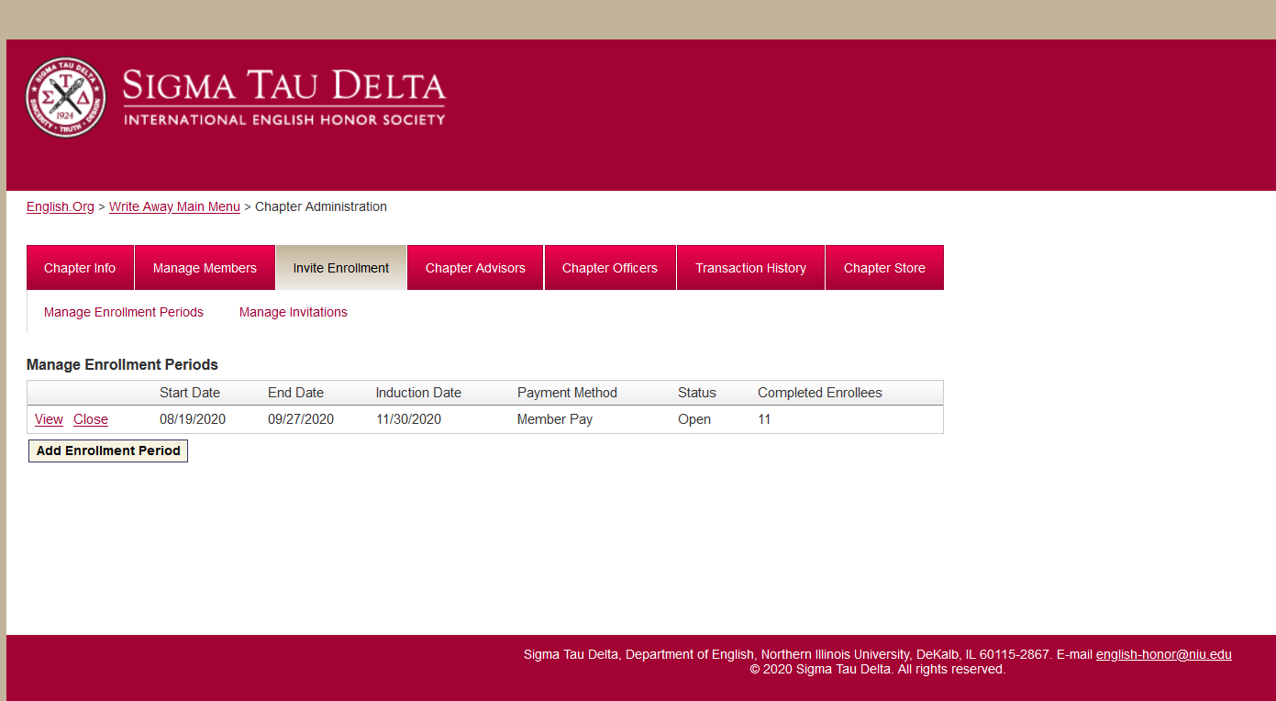
Write Away
Invite Enrollment

Slide 8
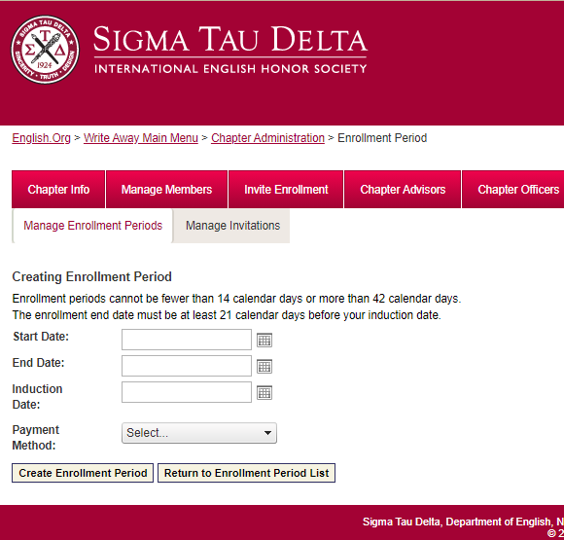
Write Away
Invite Enrollment

Slide 9
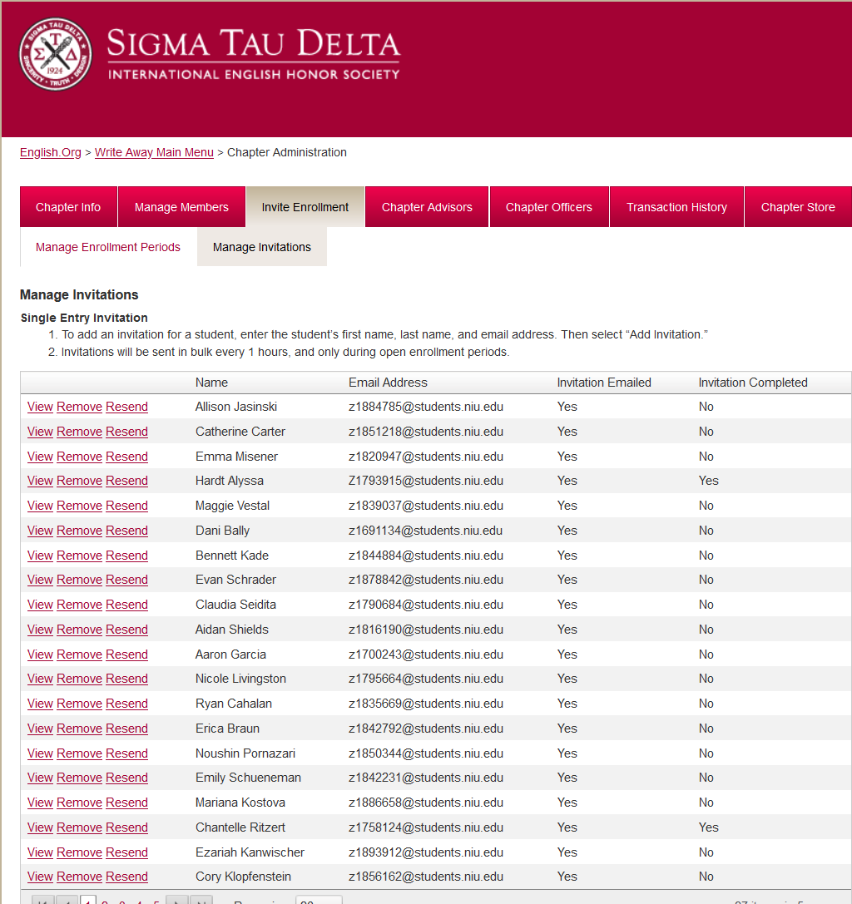
Write Away
Invite Enrollment

Slide 10
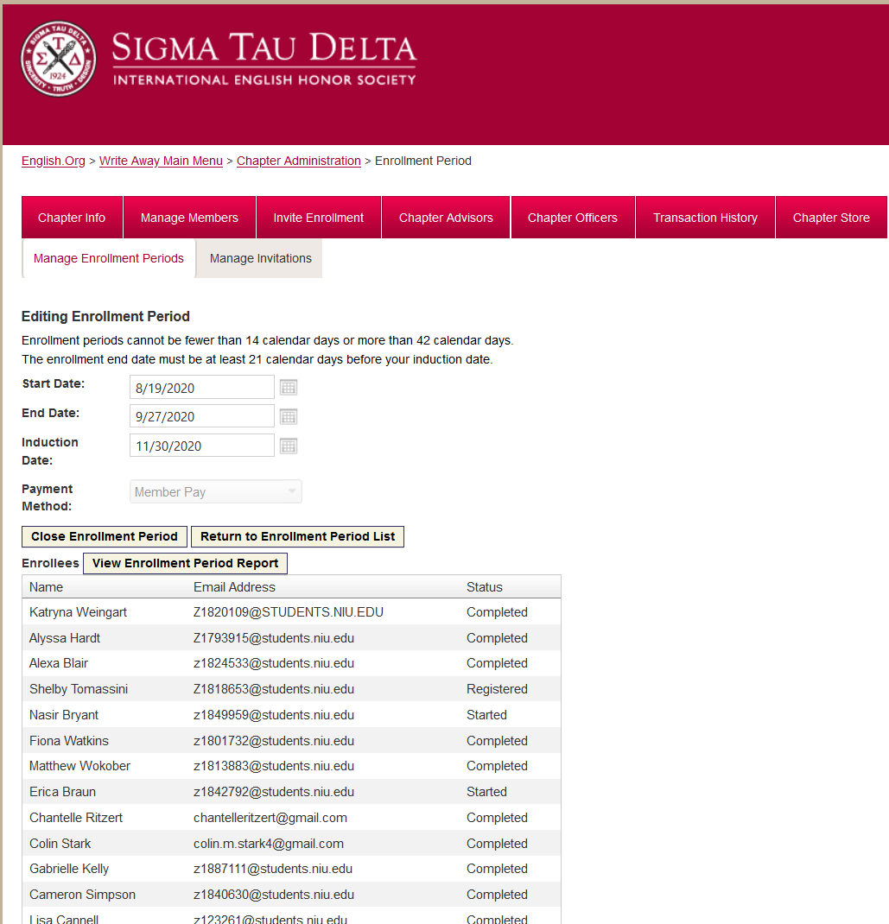
Write Away
Invite Enrollment

Slide 11
Upcoming Presentations
October
Chapter Events and Activities
January
Scholarships, Awards, and Internships
February
Student Leadership Society Positions for 2020-2021

Slide 12
Questions & Answers
Type your questions into the chat box.

